Slide 1
MIB/MS Competition analysis
Wilson/Graves Lab
UNC Proteomics Core Facility
11/24/2020
PC781

Slide 2
Sample information
Sample ID:
MRSA Resistant S. aureus cell pellet
Seven treatment conditions:
DMSO 2x, ALMDA26 1uM, ALMDA26 10uM, ALMDA26 50uM, ALMDA28 1uM, ALMDA28 10uM, ALMDA28 50uM
Sample prep & data analysis:
S. aureus lysate portioned and incubated 1hr 4⁰C with one of the above treatment conditions.
Samples were processed by Karim using the MIB/MS protocol.
Samples were analyzed using the Thermo Easy nLC 1200-Q Exactive HF.
Data were processed in MaxQuant, searched against a reviewe S. aureus database. Results were visualized/further analyzed in Perseus and Excel.
NOTE: data with missing values and/or only identified with 1 peptide were also included in the analysis
Proteomics Core ID# PC781

Slide 3
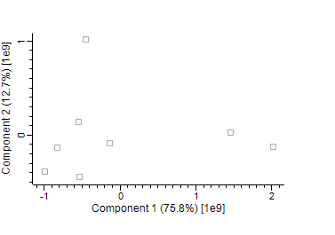
Global overview
~ 500 protein groups total detected. ~470 protein groups had at least 3 LFQ values. Protein groups with less than 3 quantified LFQ groups excluded from further analysis.
PCA analysis show 50uM treatment conditions for both compounds more dissimilar. Control 1 does not cluster well to other conditions.
NOTE: NO BIOLOGICAL REPLICATES WERE PROVIDED SO WE CANNOT DO STATISTCAL ANALYSIS.
DMSO 1
DMSO 2
ALMDA1-28 50uM
ALMDA1-26 10uM
ALMDA1-26 50uM
ALMDA1-28 1uM
ALMDA1-26 1uM
ALMDA1-28 10uM

Slide 4
Data Interpretation
I calculated a Log2 fold change (FC) of each sample compared to DMSO – based on the LFQ intensity columns H-O .
I attempted to impute missing LFQ values to generate Log2 FC values that would otherwise be missing, but imputation by averaging the lowest 1% of LFQ values generated values unusual for the range of typical values.
A log2 FC ≥-0.5 can be considered a kinase with decreased MIB binding/abundance. A more stringent cut-off is Log2FC -1 or lower.
A log2FC ≤0.5 can be considered a kinase with increased MIB binding/abundance. A more stringent cut-off is Log2FC 1 or higher.
I plotted the data in a bar chart to help visualize how protein groups responded to treatment conditions (See separate ppt). With a competition assay, the most compelling data will often be the protein groups that respond in a dose dependent manner in either direction.

